Slide 1
Data Spark: Illuminating Insights for Global Electronics
By .. Mohammed Asik Hussain.

Slide 2
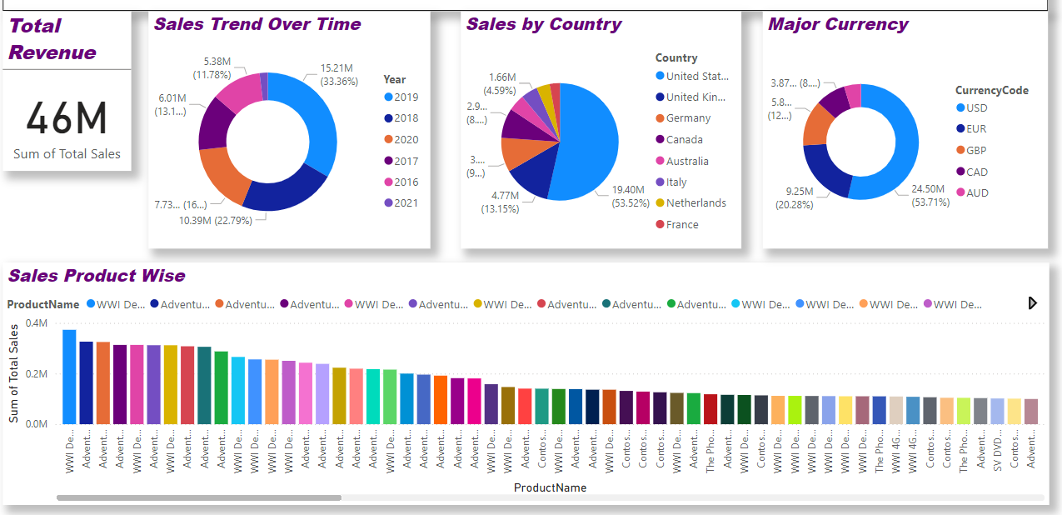
Sales Analysis:

Slide 3
Insights:
1. Sales Trends Over Time:
The year 2019 contributes the highest revenue at $15.21M (33.36%), indicating a significant increase compared to previous years.
From 2016 to 2019, there’s a clear upward trend, showing successful year-on-year growth. The sales drop in 2020 might be due to market disruptions, potentially caused by the global pandemic, which affected many industries.
2. Regional Sales Analysis:
The U.S. generates over 53% of total sales. To maintain this strong presence, marketing in this region can focus on customer retention strategies, such as loyalty programs or exclusive offers for repeat customers.
The United Kingdom, Germany, and Canada collectively contribute a substantial portion of revenue.

Slide 4
3. Major Currency Analysis:
Sales in USD account for 53.71% of total revenue, highlighting that most of the company’s sales are centered in the U.S. or dollar-based economies.
Sales also occur in other major currencies, such as EUR (20.28%) and GBP (8%).
4. Product Sales Insights:
The product-wise sales chart shows a range of best-selling items, with multiple WWI and Adventure-themed products leading.
If certain products appear lower, Global Electronics might consider reducing stock for these items, offering them in bundles, or running discount promotions to clear inventory.

Slide 5
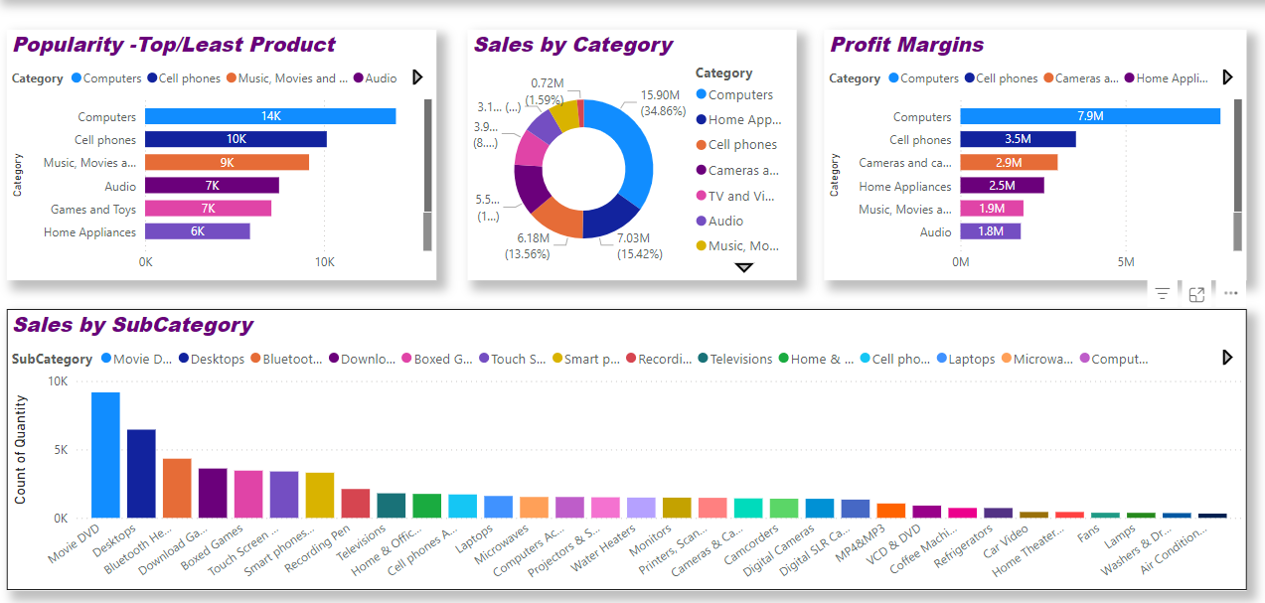
Product Analysis:

Slide 6
Insights:
1. Product popularity:
The top categories in terms of sales volume are Computers (14K units) and Cell Phones (10K units). This demand suggests that technology products are highly popular
Categories like Home Appliances (6K units) and Games and Toys (7K units) show lower sales volumes.
2. Sales by Category:
The Computers category generates 34.86% (approximately $15.9M) of total sales.
Categories like Cell Phones (15.42%) and Home Appliances (13.56%) contribute less revenue but still have substantial shares.

Slide 7
3. Profit Margins:
The highest profit margins are observed in Computers (7.9M) and Cell Phones (3.5M), aligning with their strong sales and revenue contributions.
Categories like Audio (1.8M) and Music, Movies, and Games (1.9M) show lower margins. Exploring cost efficiencies, renegotiating supplier terms, or adjusting pricing in these areas could enhance overall profitability.
4. Sales by Subcategory:
Movie DVDs lead subcategory sales with around 10K units, reflecting sustained demand in affordable entertainment.
Items like Smartphones, Laptops, and Televisions have lower unit sales. Targeted marketing and improved product visibility for these subcategories may help capture additional demand and broaden the consumer base.

Slide 8
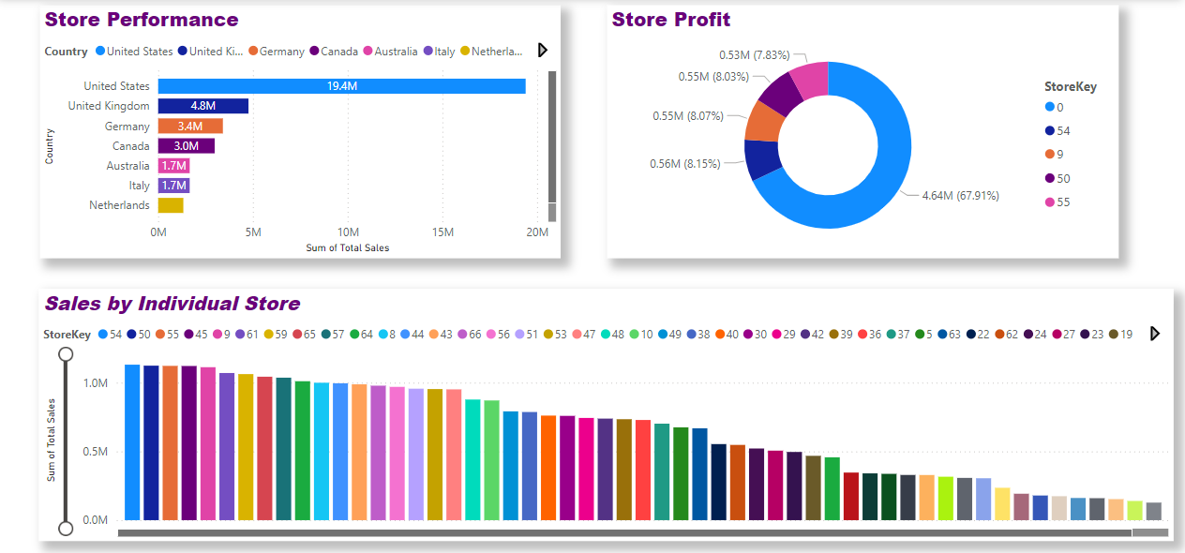
Store Analysis:

Slide 9
Insights:
1. Store Performance by Country:
The United States dominates in sales, with approximately $19.4 million in revenue. This is significantly higher than other countries, suggesting a high market penetration and strong demand in the U.S.
Countries like Canada ($3M), Australia ($1.7M), Italy ($1.7M), and the Netherlands show lower sales volumes. These regions may benefit from market analysis to understand customer needs and implement strategies to boost sales.
2. Store Profit:
A significant portion of profit, approximately 67.91% ($4.64 million), comes from Storekey 0. This indicates a high-performing store with a substantial impact on overall profitability.

Slide 10
Other stores, such as those with Storekeys 54, 9, 50, and 55, contribute smaller but still notable profits.
3. Sales by Individual Store:
Several stores (Store keys 54, 50, 55, 45, 9, 61, 59) generate similar levels of total sales, all above $1 million.
This uniformity in sales among the top-performing stores indicates a well-distributed performance among the top tier of stores.

Slide 11
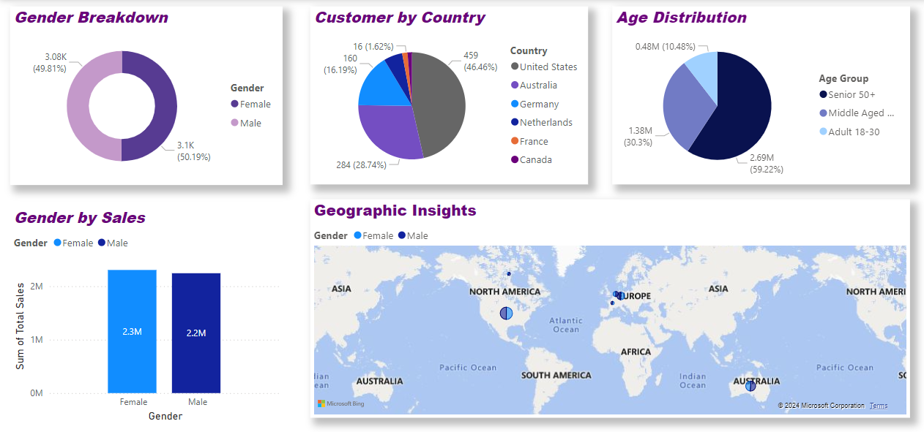
customer Analysis:

Slide 12
Insights:
1. Gender Breakdown:
The gender split is relatively balanced, with 50.19% male (3.1K) and 49.81% female (3.08K). This suggests that the customer base is almost equally distributed by gender, indicating that marketing and products appeal broadly across genders.
2. Customer by Country:
The United States dominates the customer base with 46.46% , followed by Australia 28.74%, and Germany 16.19%,. Other countries like Canada, France, and the Netherlands have smaller shares.
The U.S. and Australia are key markets, and focusing on targeted campaigns in these countries could enhance revenue.

Slide 13
3. Age Distribution:
The majority of customers fall into the Senior 50+ category, comprising 59.22% (2.69M), followed by Middle Aged (31-50) at 30.3% (1.38M), and a smaller proportion of adults aged 18-30 at 10.48% (0.48M).\
However, there may also be growth opportunities in the younger segments through targeted marketing efforts
4. Gender by Sales:
Sales are similarly distributed across genders, with females generating slightly higher total sales at 2.3M compared to 2.2M for males.
5. Geographic Insights:
The geographic map highlights key regions where customers are located, with notable engagement in North America, Europe, and Australia.

